Slide 1
Ancient Greece
500-323 B.C.E.

Slide 2
Geography
Greece is a peninsula about the size of Louisiana in the Mediterranean Sea.
It’s very close to Egypt, the Persian empire (includes Turkey) and Rome.

Slide 3
Greek geography
Greece is mountainous
Greek communities often times developed independently because of the mountains, thus they were diverse
As a result, they fought each other a lot.

Slide 4
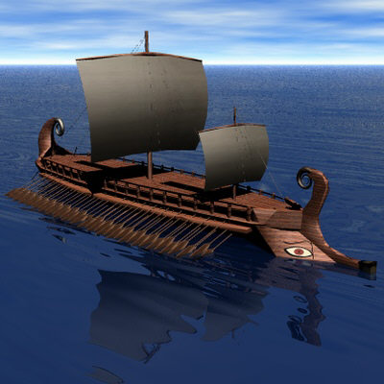
Technology results from necessity
Since Greek coastal cities were sandwiched between the ocean and the sea, they developed an awesome navy for trading and fighting.

Slide 5
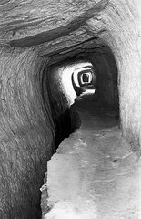
Technology results from scarcity
All cities need fresh water. This is a Greek aqueduct, basically a brick water pipe.
The first aqueduct was Assyrian, but most ancient societies had them.

Slide 6
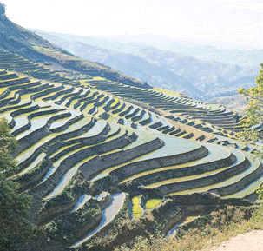
Terracing saves water and soil in mountainous environments

Slide 7
Greek Inventions
The Greeks invented dice.

Slide 8
The Greeks were the original Olympiads.
Their scientists studied the best way to
perform sports

Slide 9
Greek Invention
The Greeks invented the crane.

Slide 10
Greek Architecture
Greeks invented arches and columns.
This obviously took advanced mathematics.

Slide 11
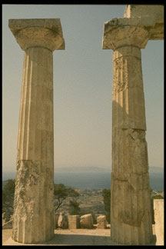
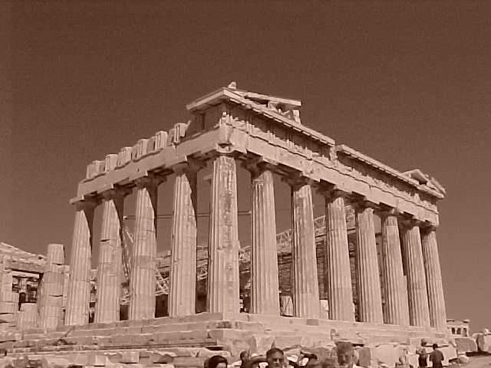
More Greek Architecture

Slide 12
Greek Military
This is a catapult, a Greek invention.
It could throw 300 pound stones at walls and buildings

Slide 13
Greek Military
This is a hoplite, a Greek infantry soldier.
Hoplites were middle-class freemen who had to pay for their own weapon and shield.

Slide 14
Greek Military
This is a phalanx.
Soldiers get in a tight box. They each have a large shield and a 9 foot long spear.

Slide 15
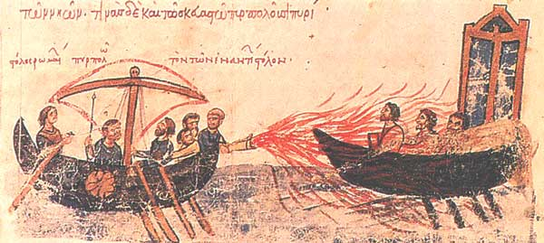
Flamethrower!!!!!

Slide 16
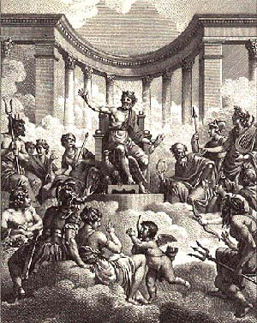
Greek religion was polytheistic.

Slide 17
Political: Athens was the first democracy.
Democracy: type of government where people vote.
Well, actually, Athens was a direct democracy where people vote on everything.
The U.S. today is a representative democracy, where we vote for people to make decisions for us.

Slide 18
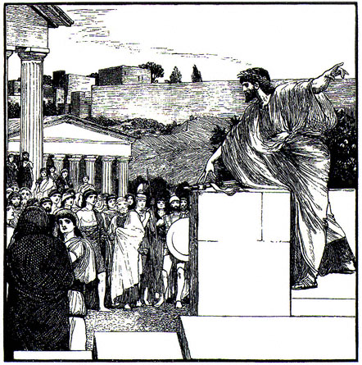
Direct participation was the key to Athenian democracy. In the Assembly, every male citizen was not only entitled to attend as often as he pleased but also had the right to debate, offer amendments, and vote on proposals. Every man had a say in whether to declare war or stay in peace. Basically any thing that required a government decision, all male citizens were allowed to participate in.

Slide 19
Remember! If you think the U.S. is so much better. . .
Some southern states did not let African Americans vote until the 1960s (Voting Rights Act 1965)
Women could not vote in the U.S. until 1920 (19th Amendment)
Eighteen year olds could not vote until the late 1970s.

Slide 20
Political terms
All of Greece wasn’t a democracy.
Most of Greece was a monarchy a type of government ruled by a king or queen.
At right is Pericles, a good king of Athens.

Slide 21
Sparta
Sparta was an isolated city-state that was culturally and politically different from Athens.
Sparta was an oligarchy, government ruled by a few. They had 2 kings.
During the Peloponnesian Sparta sacked Athens.

Slide 22
Sparta
Spartan society was obsessed with war.
Boys were sent to military school at a young age.
Boys who are born deformed are left to die on mountainsides

Slide 23
Athens
Athenians were tough but were encouraged to engage in activities like art, philosophy, music.

Slide 24
Alexander the Great
Alexander was not from Athens, but Macedonia.
Alexander was a brilliant military strategist.
His favorite book was Homer’s Iliad

Slide 25
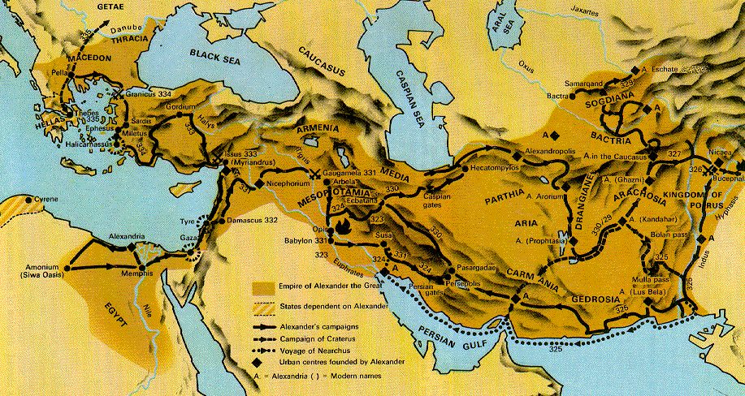
Alexander conquered the Persian empire and controlled the largest empire the world has ever seen.

Slide 26
What happens when cultures collide?

Slide 27
Alexander spread Hellenistic culture throughout Asia.
Hellenistic is a fancy word for Greek.
Alexander spread Greek technology and ideas throughout his empire

Slide 28
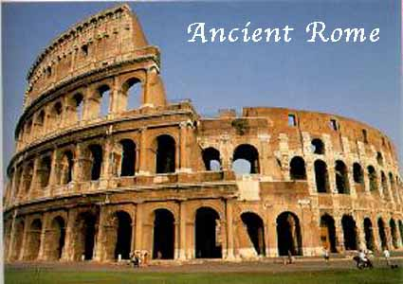
The Roman Coliseum has a strong Hellenistic influence.

Slide 29
What buildings in the USA have a Hellenistic influence?

Slide 30
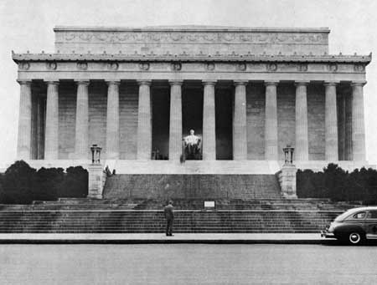
Lincoln Memorial

Slide 31
Any questions before the quiz?

Slide 32
Greece Quiz
1.What is Greece’s political contribution to the political world (especially the United States)?
2. How did geography influence Greece’s economy and military technology?
3. How did Hellenistic ideas spread throughout Asia?
4. Describe an example of how necessity brings about technological change.
5. Define monarchy
6. Define oligarchy

Slide 33
This powerpoint was kindly donated to www.worldofteaching.com
http://www.worldofteaching.com is home to over a thousand powerpoints submitted by teachers. This is a completely free site and requires no registration. Please visit and I hope it will help in your teaching.

